Slide 1
RAG Retrieval Augmented Generation

Slide 2



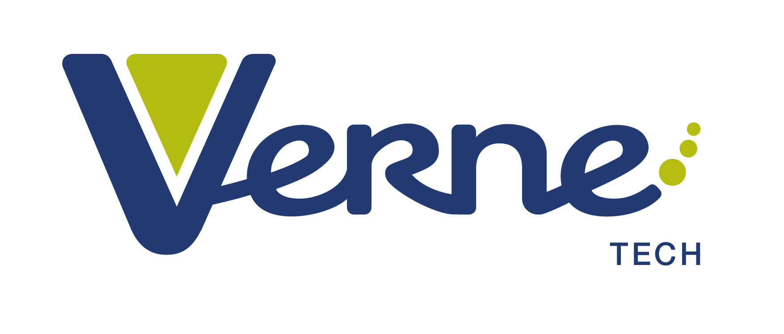

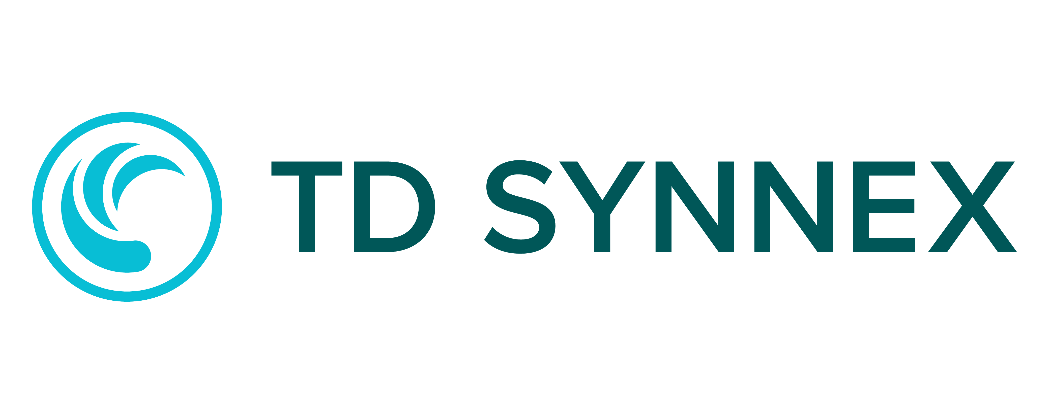


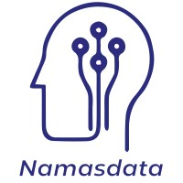
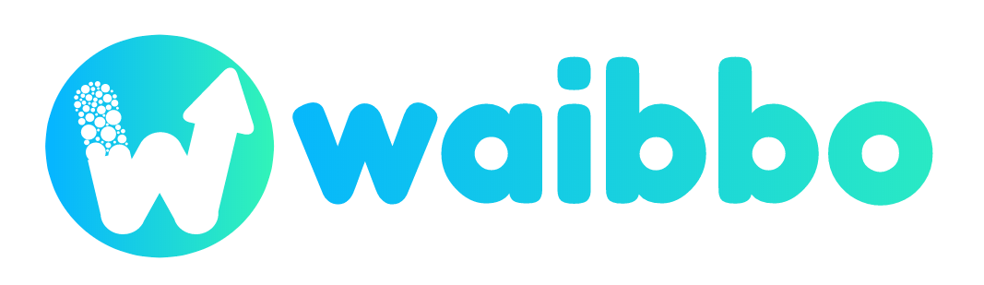
¡Gracias sponsors!
Platinum
Gold
Silver

Slide 3
Bringing Private Knowledge to LLMs
Fine tuning
Learn new skills
Retrieval
augmentation
Learn new facts
#DataSatMadrid

Slide 4




RAG – Retrieval Augmented Generation
Yes, your company perks cover underwater activities such as scuba diving lessons ¹
Do my company perks cover underwater activities?
User
Question
Document Search
Large Language Model
#DataSatMadrid

Slide 5
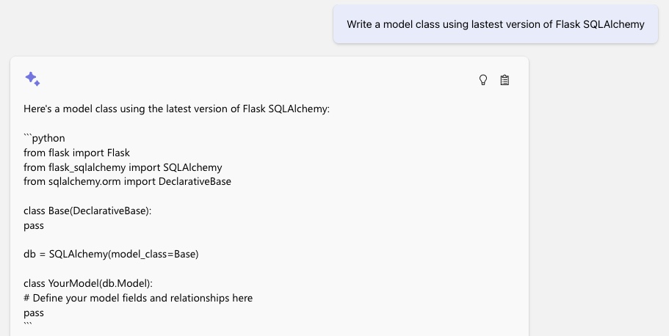
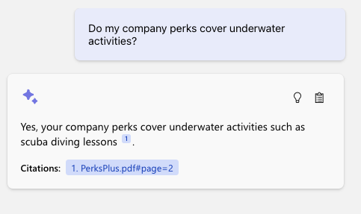
The benefit of RAG
Up-to-date public knowledge
Access to internal knowledge
#DataSatMadrid

Slide 6
Top challenges we have
Accuracy
Cost
Latency
Optimize Chunking Strategy
Consider Editing Content or format of your document for efficient processing and chunking
Chunk and Storage Optimization
Cheaper and Faster Model
Use Faster Model
Measure, Monitor and Iterate
#DataSatMadrid

Slide 7
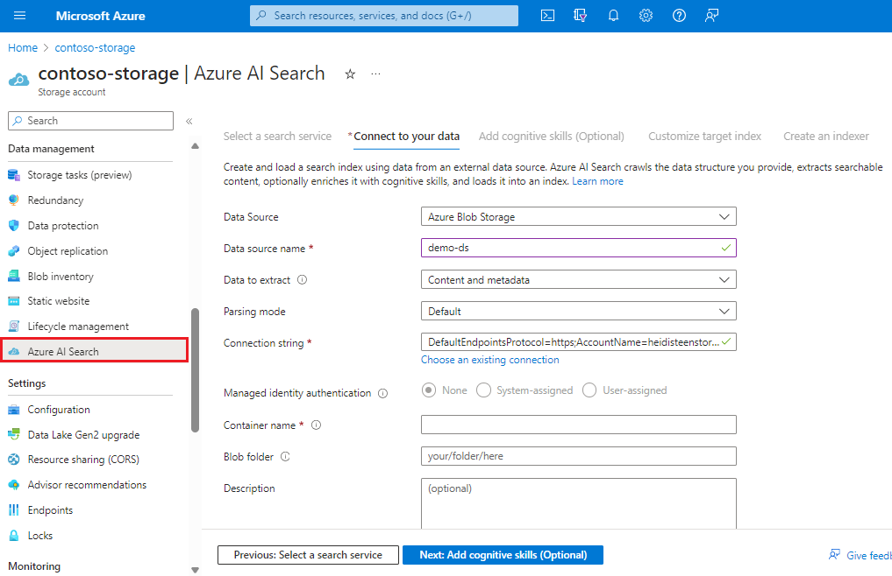
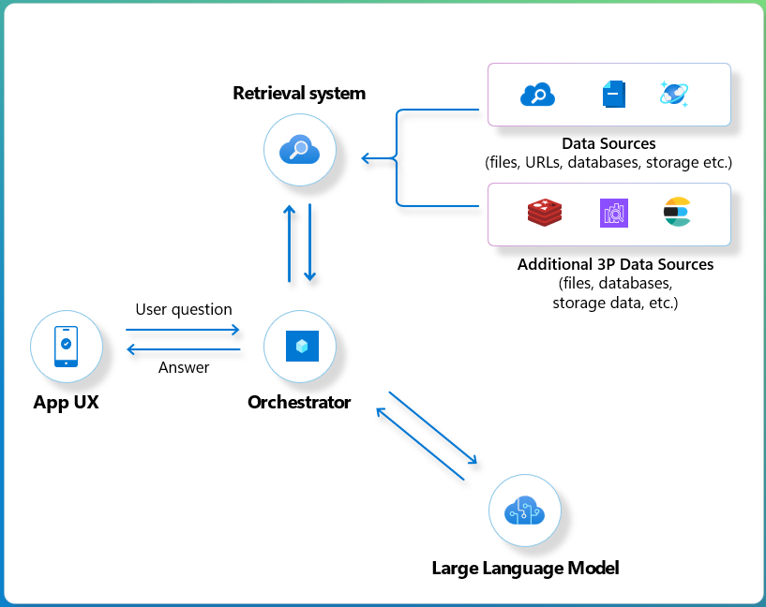
What is Azure AI Search?
Azure AI Search (AZS) is an Information Retrieval solution
What’s today’s most popular use case?
Retrieval Augmented Generation (RAG)
Text, Vector, Hybrid Search
Content understanding
Semantic Ranking
& much more
#DataSatMadrid

